Slide 1
RxNorm 101
In Hye Cho
National Library of Medicine (NLM)
National Institutes of Health (NIH)
U.S. Department of Health & Human Services (HHS)

Slide 2
What is RxNorm?
Drug terminology authored by NLM
  Set of normalized medication names and codes
  Terminology derived from other drug terminologies
  Link between disparate drug terminologies

Slide 3
What is RxNorm?
Collection of commonly-used public and commercial drug vocabularies containing drug names and their ingredients*:
FDA Structured Product Labels (DailyMed)
VA National Drug File
CMS Formulary Reference File
MeSH
NLM: RXNORM
First DataBank
Gold Standard
Multum
Anatomical Therapeutic Chemical Classification System
DrugBank
SNOMED CT
*In most cases we only load a subset of the source into the RxNorm data set

Slide 4
What RxNorm is NOT
RxNorm is not a terminology for:
  Diagnostic products
  Medical devices
  Medical foods
  Compounded drugs
  Homeopathic products
  Radiopharmaceuticals
These are out-of-scope and do not receive an RxNorm normalized name or an RxNorm Concept Unique Identifier (RXCUI) in the RxNorm terminology

Slide 5
RxNorm Scope
In-Scope (RXCUIs more stable)
  Therapeutic U.S. medications
    Human & some veterinary
    Prescription & some OTC
Out-of-Scope (RXCUIs can be transient)
  Diagnostic medications
  Non-U.S. medications
  Medical devices & supplies
  Medical foods
  Homeopathics
  Radiopharmaceuticals
  Compounded drugs
Source Data
Source Data
RxNorm Terminology (in-scope)
Source Data
Source Data
Source Data
Source Data

Slide 6
How is RxNorm used?
ePrescribing
Formulary development and maintenance
Medication history
Research data management

Slide 7
How is RxNorm used?
Center for Medicare and Medicaid Services (CMS)
  Formulary Reference File
  Clinical Quality Measures (CQMs), Meaningful Use Value Sets
Office of the National Coordinator (ONC)
  Standard for medications
  Required for Electronic Health Record (EHR) certification
National Council for Prescription Drug Programs (NCPDP)
  SCRIPT ePrescribing standard
  Formulary and Benefit standard
Veterans Affairs – Department of Defense (VA-DoD)

Slide 8
Why RxNorm?
Sample drug names from different drug vocabularies:
ALBUTEROL SULFATE 1.5 mg in 3 mL RESPIRATORY (INHALATION) SOLUTION
Albuterol Sulfate, 1.25 mg/3 mL (0.042%) inhalation solution
Salbutamol sulfate 417 microgram/mL solution for inhalation
ALBUTEROL SO4 0.042% INHL,3ML
albuterol 1.25 mg/3 mL (0.042%) inhalation solution
Albuterol Sulfate 1.25mg/3mL Nebulizer solution
ALBUTEROL SO4 0.042% 3ML INHL
albuterol sulfate 1.25 mg/3 mL INHALATION VIAL, NEBULIZER (ML)
albuterol sulfate 1.25 mg/3 mL INHALATION VIAL, NEBULIZER (ML)
albuterol sulfate@1.25 mg/3 mL@INHALATION@VIAL, NEBULIZER (ML)
ALBUTEROL SULFATE 1.25 mg in 3 mL RESPIRATORY (INHALATION) SOLUTION
Albuterol Sulfate 0.042% Inhalation Solution
ALBUTEROL SULFATE 1.25 mg in 3 mL INTRABRONCHIAL SOLUTION

Slide 9
Why RxNorm?
ALBUTEROL SULFATE 1.25 mg in 3 mL INTRABRONCHIAL SOLUTION
ALBUTEROL SULFATE 1.5 mg in 3 mL RESPIRATORY (INHALATION) SOLUTION
ALBUTEROL SO4 0.042% INHL,3ML
RxNorm normalized name:
  Albuterol 0.417 MG/ML Inhalation Solution
RxNorm concept unique identifier (RXCUI):
  351136

Slide 10
Why RxNorm?
National Drug Code (NDC) - unique, three-segment, numerical drug product identifier
00143 – 3991 – 01
Labeler - Product - Package code size

Slide 11
Why RxNorm?
Sample of National Drug Code (NDCs) from drug vocabularies:
00487-9904-01
0487-9904-02
0487-9904-25
0378-6992-52
00378699252
00378699298
00487990401
00487990425
00591346853
049502069303
00121-4727-10
00487990425
00591346853
54868570900
0591-3468-53
00378-6992-52
54868-5709-0
00487-9904-01
  Albuterol 0.417 MG/ML Inhalation Solution (RXCUI 351136)

Slide 12
How is RxNorm created?
Create unique identifier
(RXCUI=351136)
Create normalized name*
(Albuterol 0.417 MG/ML Inhalation Solution)
Group synonymous terms (into a concept)
(ALBUTEROL SO4 0.042% 3ML INHL, Albuterol Sulfate 1.25mg/3mL Nebulizer solution, ALBUTEROL SULFATE 1.5 mg in 3 mL RESPIRATORY (INHALATION) SOLUTION)
*Out-of-scope information does not receive a normalized name. Radiopharmaceuticals, medical devices, homeopathics, among others are out-of-scope.

Slide 13
RxNorm Drug Terminology
Data model
  Ingredient + Strength + Dose form
  Semantic Clinical Drug (SCD)
  Basic building block for fully specified clinical drug names
Organizes and links source data with an RxNorm Concept Unique Identifier (RXCUI)

Slide 14
RxNorm Drug Terminology
Ingredient + Strength + Dose form
If any of the three elements is different between drugs, a different name and RXCUI is assigned
Fluoxetine 20 MG Oral Capsule RXCUI 310385
Fluoxetine 40 MG Oral Capsule RXCUI 313989

Slide 15
How is the RxNorm Terminology Structured?
Concepts at various levels of specificity
  Labeled with term type (TTY); Identified with RXCUI
TTY | Ingredient | Strength | Dose Form | Brand Name | RXCUI
IN | Fluoxetine |  |  |  | 4493
SCDC | Fluoxetine | 40 MG |  |  | 330341
SCDF | Fluoxetine |  | Oral Capsule |  | 372231
SCD | Fluoxetine | 40 MG | Oral Capsule |  | 313989
SBD | Fluoxetine | 40 MG | Oral Capsule | [Prozac] | 261287
SBDF | Fluoxetine |  | Oral Capsule | [Prozac] | 93904
SBDC | Fluoxetine | 40 MG |  | [Prozac] | 574512
BN |  |  |  | Prozac | 58827

Slide 16
How is the RxNorm Terminology Structured?
SCD – generic drug
  Pravastatin Sodium 20 MG Oral Tablet
SBD – branded drug
  Pravastatin Sodium 20 MG Oral Tablet [Pravachol]
  GPCK – generic pack
    {30 (Aspirin 325 MG Oral Tablet) / 30 (Pravastatin Sodium 20 MG Oral Tablet) } Pack
  BPCK – branded pack
    {30 (Aspirin 325 MG Oral Tablet) / 30 (Pravastatin Sodium 20 MG Oral Tablet
    [Pravachol]) } Pack [Pravigard 325/20]

Slide 17
How is the RxNorm Terminology Structured?
Flexibility in the Data Model
  Quantity Factor
    2500 MG Androgel 0.01 MG/MG Topical Gel
    5000 MG Androgel 0.01 MG/MG Topical Gel
  Qualitative Distinction
    Atrial Fibrillation Sotalol Hydrochloride 120 MG Oral Tablet
    Microencapsulated Potassium Chloride 10 MEQ Extended Release Oral Tablet

Slide 18
How is the RxNorm Terminology Structured?
Relationships connect concepts
  SCD has_tradename SBD
  BPCK contains SCD consists_of SCDC has_ingredient IN
  SBD has_doseform DF
RXCUIs have associated attributes
  NDC
  RXN_HUMAN_DRUG
  RXN_VET_DRUG

Slide 19
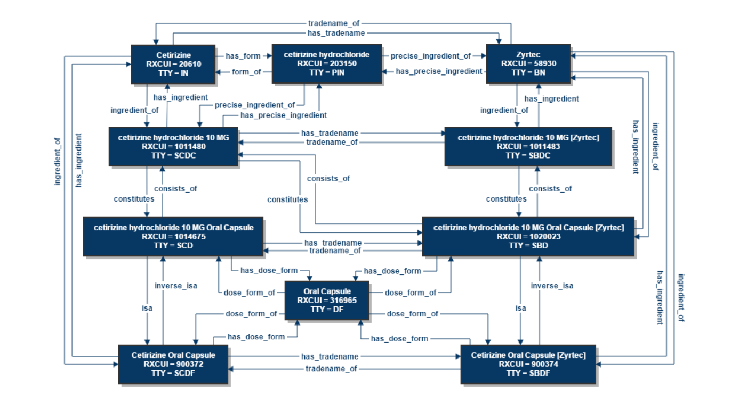
RxNorm Data Model https://www.nlm.nih.gov/research/umls/rxnorm/overview.html

Slide 20
RxNorm Data Files
Nine pipe-separate text files loosely grouped into three categories:
Main Content
Metadata
RXNCONSO
Names & Codes
  RXCUI
  STR
RXNREL
Relationships
  RXCUI1
  RXCUI2
  RELA
RXNSAT
Attributes
  NDC
  RXCUI
RXNSTY
Semantic Types
  RXCUI
  STY
RXNSAB
Source Information
  SLC
  SCC
RXNDOC
Data Type Explanation
  KEY
  EXPL
Data History
RXNCUI
  VER_START
  VER_END
RXNCUICHANGES
  OLD_RXCUI
  NEW_RXCUI
RXNATOMARCHIVE
  RXCUI
  ARCHIVE_TIMESTAMP

Slide 21
RxNorm Data Files: Main Content
RXNCONSO
  Names and Codes
    Aspirin 100 MG Oral Tablet
RXNREL
  Relationships and Codes
    tradename_of
RXNSAT
  Attributes and Codes
    NDC

Slide 22
How do I access RxNorm data?
January 2020 Release:
  Generic drugs (SCD) 36,927
  Branded drugs (SBD) 22,758
  Generic packs (GPCK) 621
  Branded packs (BPCK) 685

Slide 23
How do I access RxNorm data? http://www.nlm.nih.gov/research/umls/rxnorm/
Monthly zip file*
  Weekly updates for newly added FDA drug labels
Current Prescribable Content subset zip file
RxNav
  RxNorm browser with add-on features
APIs – RxNorm, Current Prescribable Subset
*Requires a (free) UMLS license

Slide 24
Free UMLS License https://uts.nlm.nih.gov/license.html
Proprietary and open data in RxNorm data set
Basic Usage Permissions and Restrictions
  UMLS License
    Source Restriction Level
  Contact terminology sources directly for more information
    RXNSAB.RRF file

Slide 25
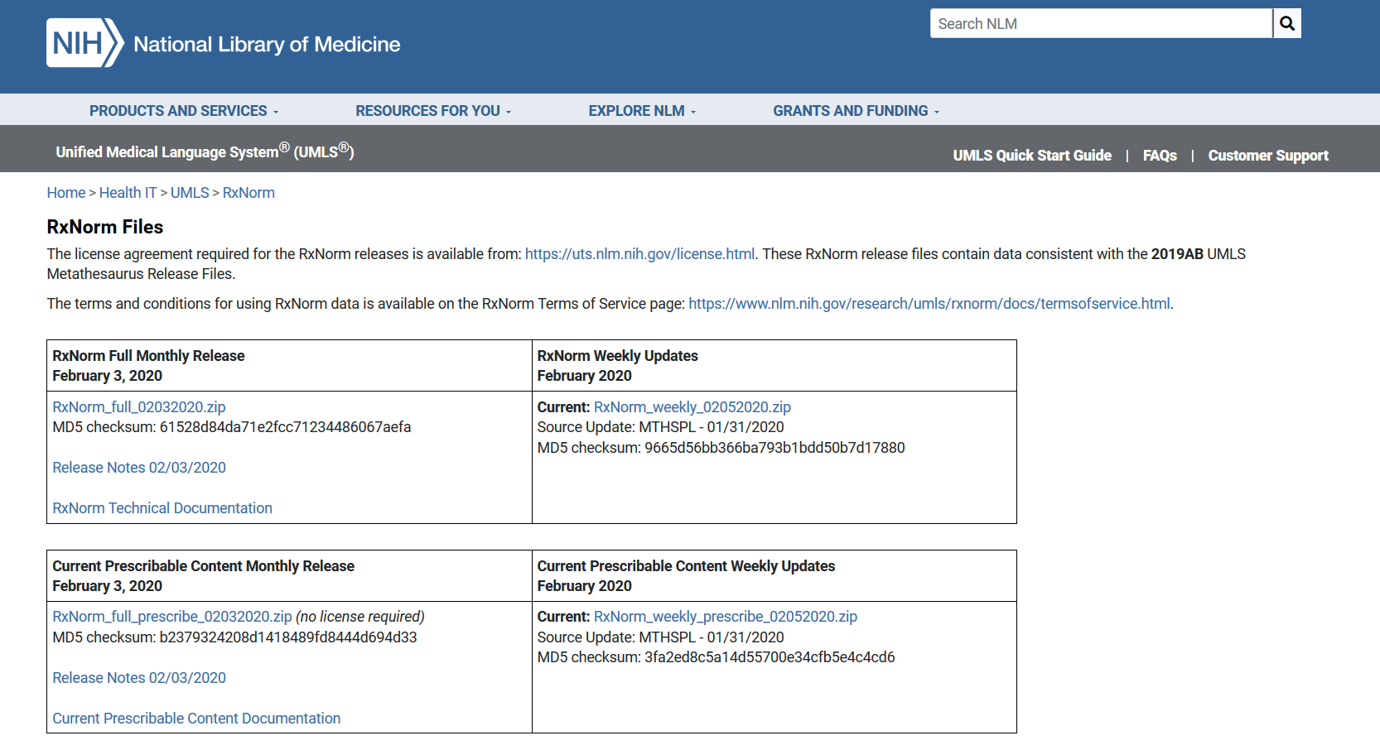
RxNorm Files Page
https://www.nlm.nih.gov/research/umls/rxnorm/docs/rxnormfiles.html

Slide 26
RxNorm Releases
120+
Releases
per year
RxNorm Release Description | Release Date/Timing
Full Monthly Release (UMLS License Required) | First Monday of the Month (Tuesday if Monday is a holiday)
Full Weekly Release (UMLS License Required) | Every Wednesday (except before May & Nov Full Monthly Releases)
Current Prescribable Content Monthly Release (No license required) | First Monday of the Month (Tuesday if Monday holiday)
Current Prescibable Content Weekly Release (No license required) | Every Wednesday (except before May & Nov Full Monthly Releases)

Slide 27
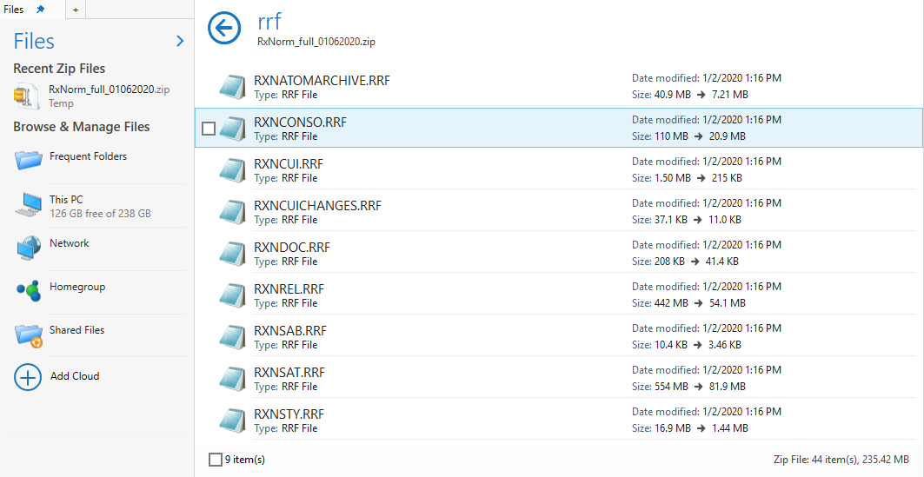
RxNorm Data Files

Slide 28
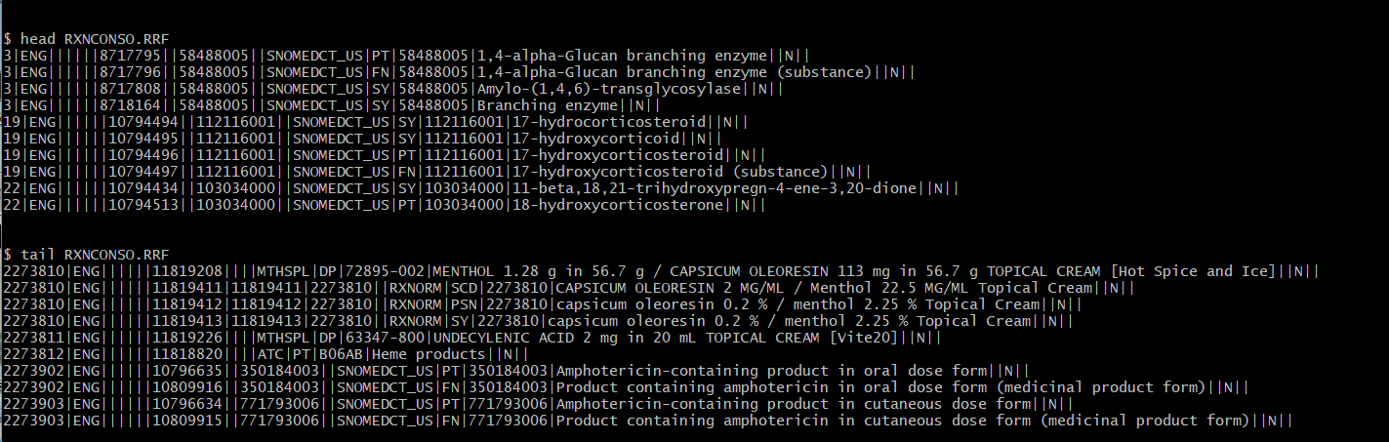
RXNCONSO.RRF https://www.nlm.nih.gov/research/umls/rxnorm/docs/techdoc.html#s12_4

Slide 29
RXNCONSO
https://www.nlm.nih.gov/research/umls/rxnorm/docs/techdoc.html#s12_4

Slide 30
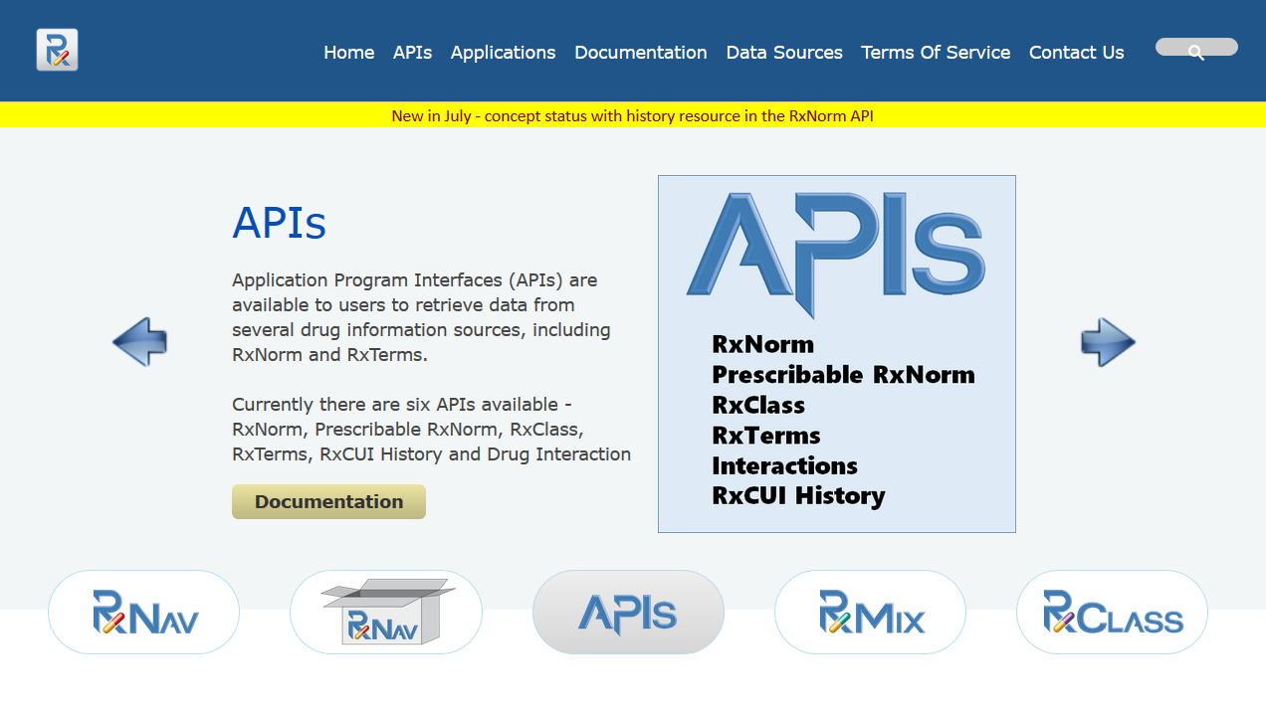
Web-Based Drug Information Resources https://rxnav.nlm.nih.gov/
RXNAVINFO@LIST.NIH.GOV

Slide 31
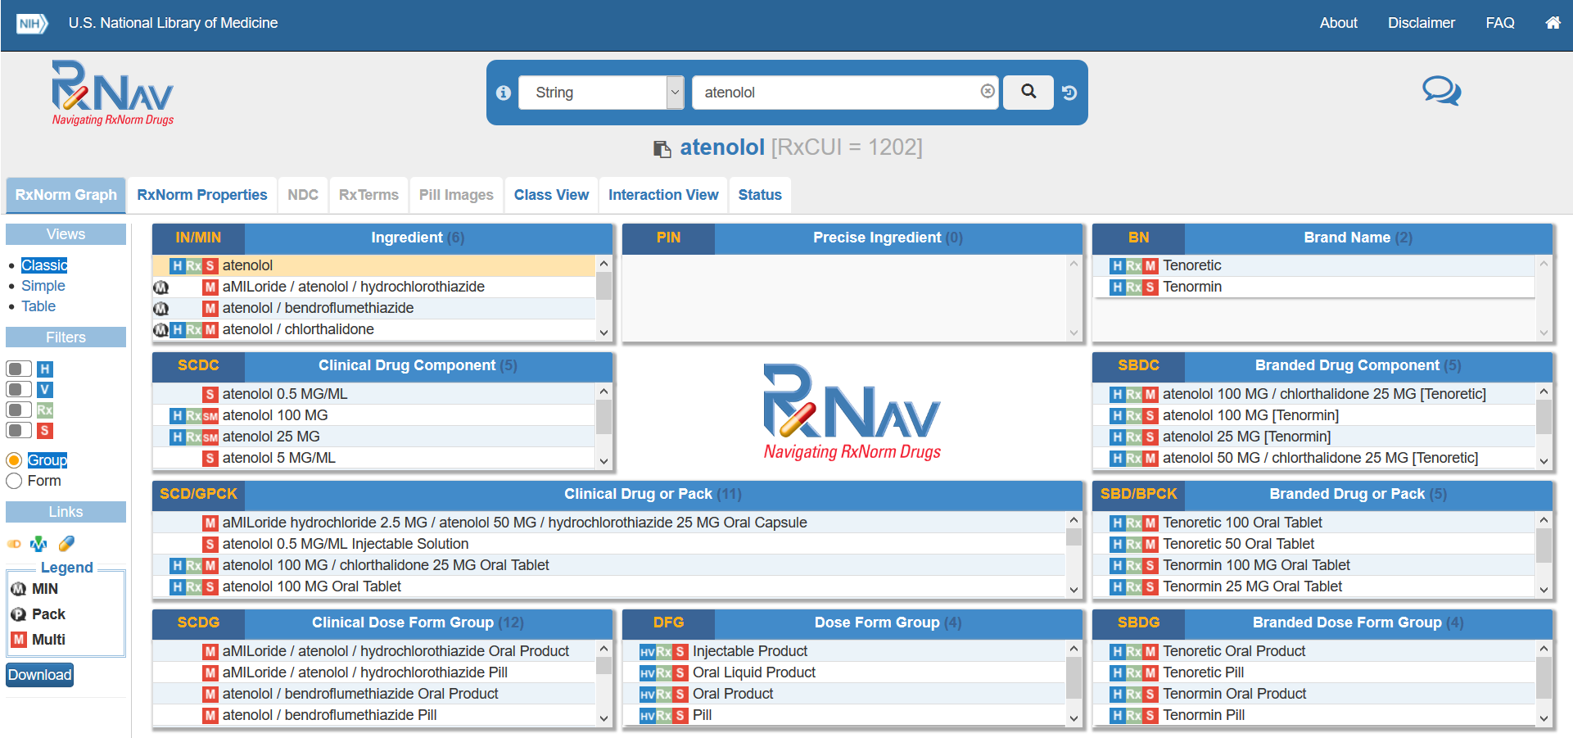
RxNav Browser https://rxnav.nlm.nih.gov/
RXNAVINFO@LIST.NIH.GOV

Slide 32
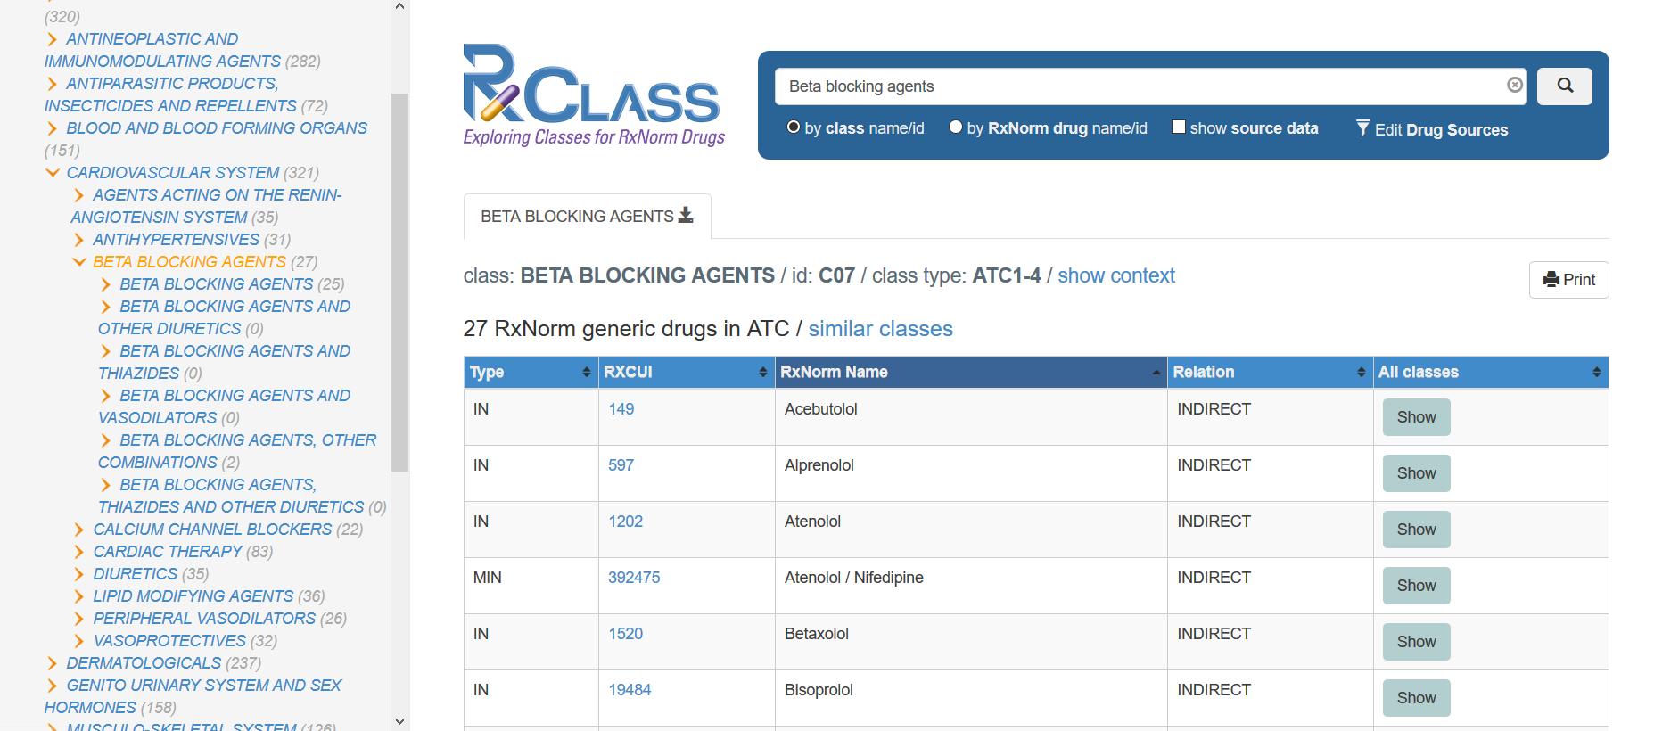
RxClass Browser https://rxnav.nlm.nih.gov/
RXNAVINFO@LIST.NIH.GOV

Slide 33
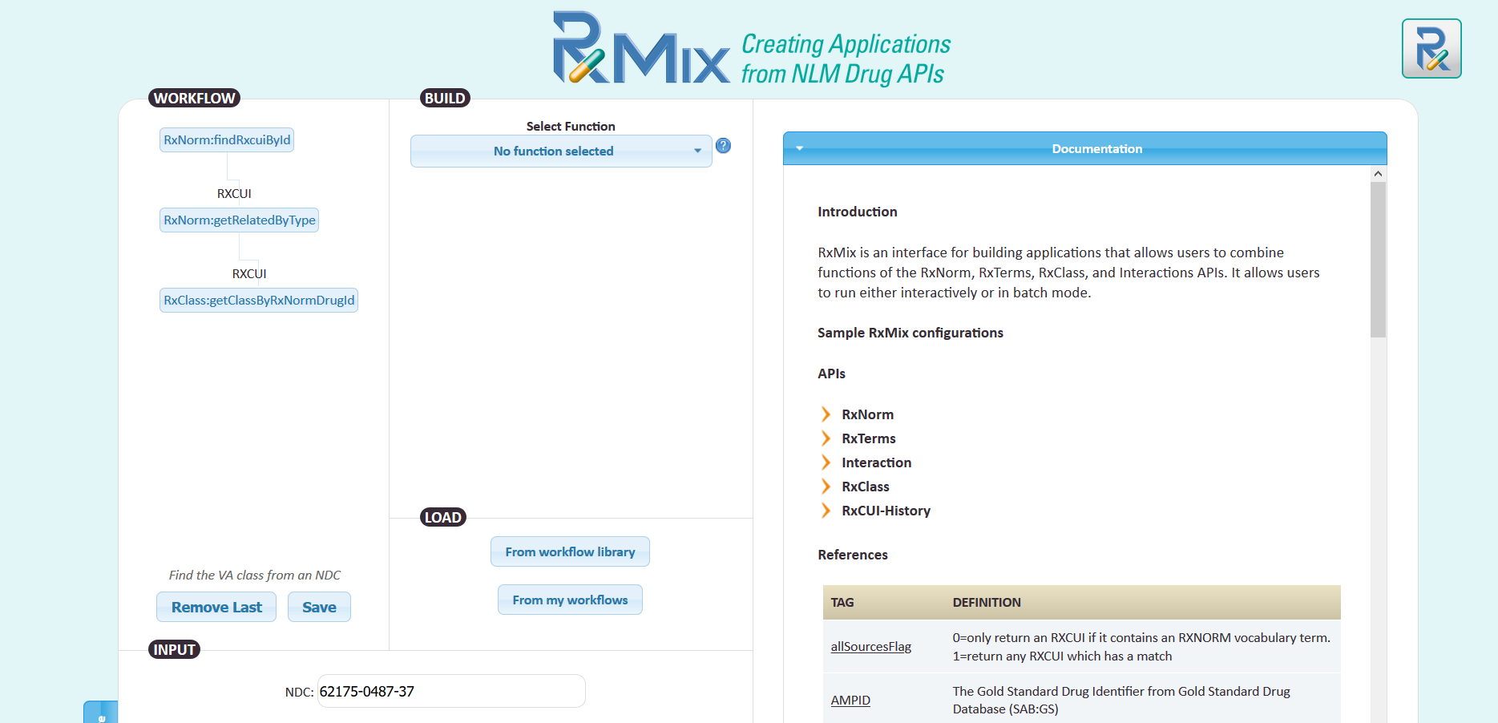
RxMix Combines API Functions https://rxnav.nlm.nih.gov/
RXNAVINFO@LIST.NIH.GOV

Slide 34
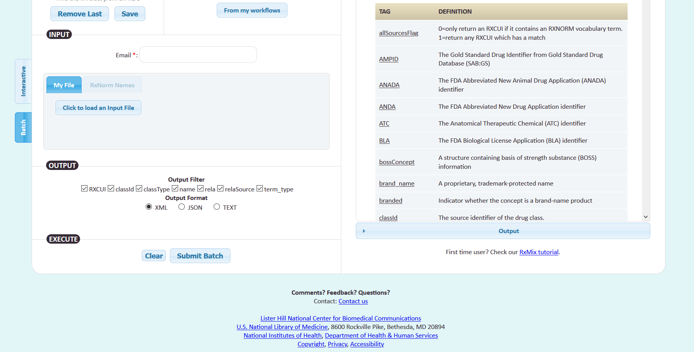
RxMix Batch Mode https://rxnav.nlm.nih.gov/
RXNAVINFO@LIST.NIH.GOV

Slide 35
Questions?
rxnorminfo@nlm.nih.gov
https://www.nlm.nih.gov/research/umls/rxnorm/index.html

