Slide 1


Mapping from SNOMED CT to ICD-10 and ICD-10-CM
Dr. Kin Wah Fung
U.S. National Library of Medicine,
Bethesda, MD, USA

Slide 2
Background
SNOMED CT is inherently more suitable for clinical documentation in an Electronic Health Record (EHR)
  Content coverage
  Clinical orientation
  Flexible data entry and retrieval
  Extensibility
Requirements for ICD-10 (mortality report to WHO) and ICD-10-CM (reimbursement starting Oct 2013) codes have a strong influence on EHR development
A map from SNOMED CT to ICD will promote the use of SNOMED CT for clinical documentation while allowing the generation of administrative codes
Other potential benefits: improve speed and quality of ICD coding

Slide 3
Two mapping projects
Mapping SNOMED CT to ICD-10
  Joint effort between IHTSDO and WHO
  International participation (including USA, UK, Canada, Sweden, Australia, and New Zealand)
  Funded by IHTSDO with a lot of volunteer contribution
Mapping SNOMED CT to ICD-10-CM
  Led by NLM with direct involvement from National Center for Health Statistics (NCHS)
  Methodology and tools – based on ICD-10 Map project
A lot of overlap between the 2 projects – people, methodology, tooling, mapping data

Slide 4
Rule-based mapping
At run-time resolve to
Final map
Map group 1
  Rule 1 → target code 1
  Rule 2 → target code 2
Map group 2
  Rule 1 → target code 3
  Rule 2 → target code 4
Map group 3
  Rule 1 → target code 5
  Rule 2 → target code 6
code1
Codes 1 + 4 +6
code4
code6

Slide 5
Multiple ICD codes – dagger and asterisk
Source concepts which map to ICD chapters with asterisk conventions will be mapped to two target codes.
The asterisk classification will always be the second map group
Source concept: 111900000 Pneumonia in aspergillosis (disorder)
Map group 1
  Rule 1 → B44.1 Other pulmonary aspergillosis
Map group 2
  Rule 1 → J17.2 Pneumonia in mycoses
Notes:
Page 25
Dagger and asterisk codes may appear in maps employing multiple other complex features. When doing so, the dagger exclusions are given priority in the Map priority sequence so as to avoid coding conflicts in the record with other exclusion codes.
Dagger codes identified during tabular review which do not have a corresponding asterisk are called “virtual dagger” references. These do not require second target addition as in the following example.
“Urinary tract infectious disorder” 68566005 maps to N39.0 with multiple exclusions. One exclusion is dagger code A18.1 Tuberculosis of genitourinary system. However review of the tabular guidance from WHO documents (B:Exclusions:#7)

Slide 6
Multiple ICD codes – External causes
The source concepts denoting a condition with an identifiable cause within scope of ICD‑10 chapter XX(20) will be mapped to two target codes.
The external cause code will be assigned to the second target record.
Source concept: 242012005 Thermal burns from lightning (disorder) :
Map group 1
  Rule 1 → T30.0 Burn of unspecified region
Map group 2
  Rule 1 → X33 Victim of lightning
Notes:
Page 24

Slide 7
Map rule – gender
Source concept: 8619003 Infertile (finding)
Map group 1
  Rule 1 IFA 1086007| FEMALE (FINDING) | → N97.9 Female infertility, unspecified
  Rule 2 IFA 248153007 | MALE (FINDING) | → N46 Male infertility
  Rule 3 OTHERWISE TRUE -> NULL

Slide 8
Map rule – age of onset
Source concept: 32398004 Bronchitis (disorder)
Map group 1
  Rule 1 IF 44518008 | AGE AT ONSET OF CLINICAL FINDING (OBSERVABLE)| < 15 YEARS → J20.9 Acute bronchitis, unspecified
  Rule 2 OTHERWISE TRUE → J40 Bronchitis not specified as acute or chronic

Slide 9
Map rule – exclusions
Source concept: 367403001 Pyloric stenosis (disorder)
Map group 1
  Rule 1 IFA 204671009 | CONGENITAL PYLORIC STENOSIS (DISORDER) | OR DESCENDANTS → Q40.0 Congenital hypertrophic pyloric stenosis
  Rule 2 OTHERWISE TRUE → K31.1 Adult hypertrophic pyloric stenosis

Slide 10
Map advice
Explicit guidance on the map’s usage
  DESCENDANTS NOT EXHAUSTIVELY MAPPED
  EPISODE OF CARE INFORMATION NEEDED
  CONSIDER ADDITIONAL CODE TO IDENTIFY SPECIFIC CONDITION OR DISEASE
  CONSIDER LATERALITY SPECIFICATION
  CONSIDER TRIMESTER SPECIFICATION
  CONSIDER WHICH FETUS IS AFFECTED BY THE MATERNAL CONDITION
  POSSIBLE REQUIREMENT FOR AN EXTERNAL CAUSE CODE
  THIS IS A MANIFESTATION CODE FOR USE IN A SECONDARY POSITION
  THIS IS AN EXTERNAL CAUSE CODE FOR USE IN A SECONDARY POSITION

Slide 11
Dual independent mapping
Built-in quality assurance process – each map has to be agreed by 2 independent sources
  Concepts with no legacy maps – mapped independently by 2 map specialists
  Concepts with legacy maps – mapped by 1 map specialist first, and by another if there is discordance between legacy map and 1st map specialist
Sources of legacy maps
  Existing UK maps (to ICD-10)
  CMT maps (to ICD-10-CM)
  UMLS synonymy
  ICD-10-CM maps derived from finalized ICD-10 maps
Minor conflicts resolved by map leads
Otherwise referred for broader discussion or consensus management panel

Slide 12
Intended uses of the map
Embedded in the EHR for real-time, interactive ICD codes generation (I-MAGIC=Interactive Map-Assisted Generation of ICD Codes)
To assist coding professionals by suggesting ICD codes based on SNOMED CT-encoded problem list entries

Slide 13
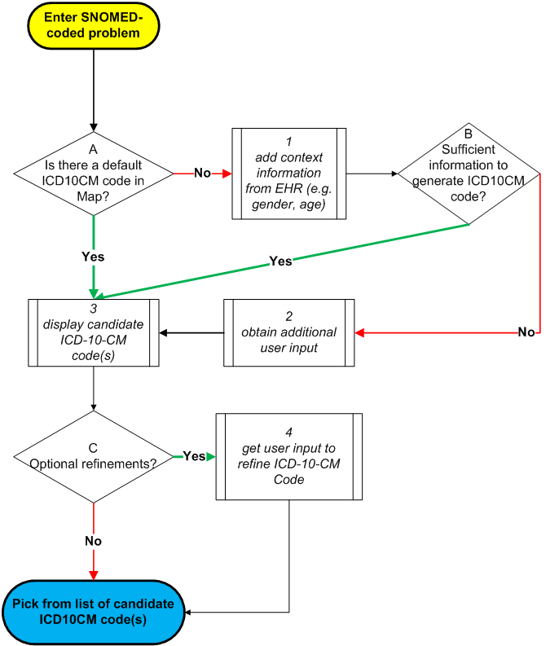
Interactive Map-Assisted Generation of ICD Codes (I-MAGIC) Algorithm

Slide 14
SNOMED CT concepts that are in scope for mapping
Any concept in the following three SNOMED CT hierarchies
  Clinical finding
  Event
  Situation with explicit context
Total about 110,000 concepts in scope

Slide 15
Priorities for phase 1 work
ICD-10 map
  NLM’s CORE Problem List Subset
  SNOMED CT concepts that correspond to top ranking ICD-10 codes in 5 countries
ICD-10-CM map
  NLM’s CORE Problem List Subset
  Donated content from Kaiser Permanente’s Convergent Medical Terminology (CMT) – top 2,500, sub-specialty subsets (cardiology, neurology, mental health, musculo-skeletal)

Slide 16
Work progress
ICD-10 map
  Preview publication of maps for 5,000 concepts in September 2011
  Final publication of phase 1 maps (about 20,000 concepts) planned for April 2012
ICD-10-CM map
  Planned release dates
    Feb 2012 – preview release (6,000 concepts)
    June 2012 – full phase 1 maps (15,000 concepts)

Slide 17
I-MAGIC demo tool
http://imagic.nlm.nih.gov/imagic/code/map

Slide 18
Questions?
kfung@mail.nih.gov

