Slide 1
Fellows, print, disaster information and consumer health
Joyce E.B. Backus
Associate Director for Library Operations

Slide 2

NLM Associate Fellows
2012-2013
Rose Hedberg, Diana Almader-Douglas, Karen Gutzman, Kevin Read
Notes:
From left to right:
Rose Hedberg; Spring Practica – Harriet F. Ginsburg Health Sciences Library, University of Central Florida College of Medicine; Orlando, FL
Diana Almader-Douglas; Lister Hill Library, University of Alabama at Birmingham
Karen Gutzman, Spring Practica – Robert B. Greenblatt Library, Georgia Regents University; Augusta, GA
Kevin Read, Spring Practica – Lamar Soutter Library, University of Massachusetts Medical School; Worcester, MA

Slide 3
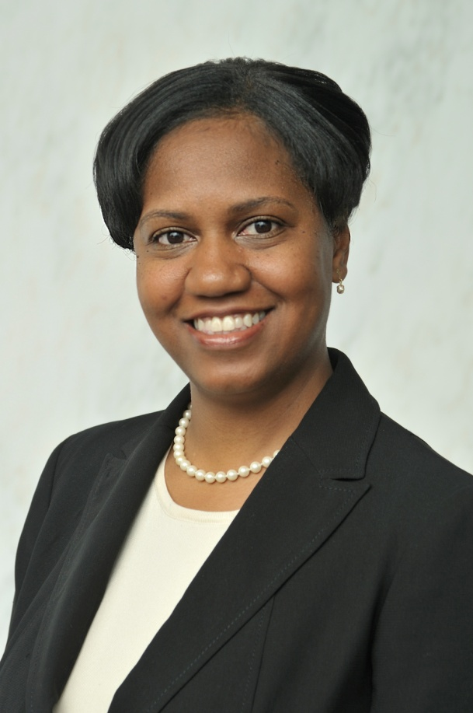
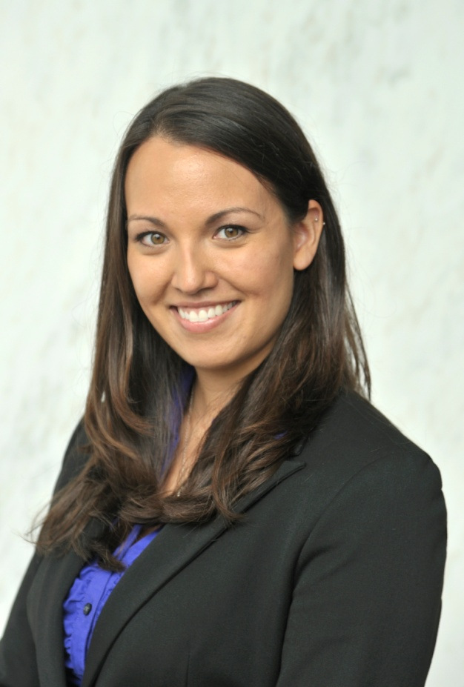
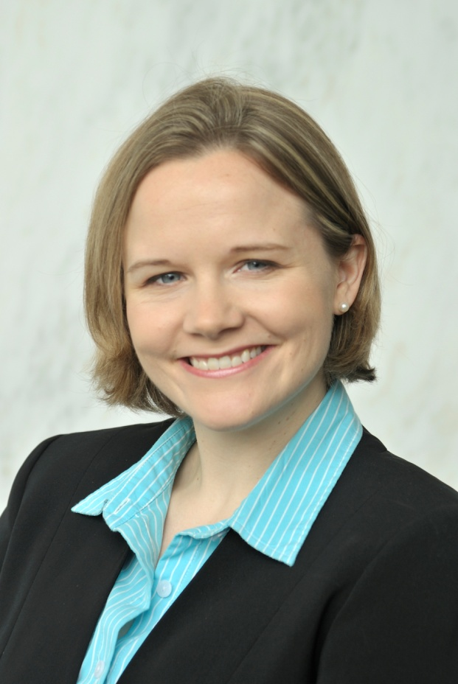
NLM Associate Fellows
2nd year
Michele Mason-Coles
Suzy Roy
Jessi Van Der Volgen
Notes:
From left to right:
Michele Mason-Coles, Zylman Health Sciences Library, Inova Fairfax Hospital, Fairfax, VA
Suzy Roy, NIH Library, Bethesda, MD
Jessi Van Der Volgen, Spencer S. Eccles Health Sciences Library, University of Utah, Salt Lake City, UT

Slide 4
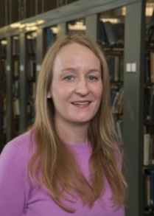

Literature Selection Technical Review Committee (LSTRC) Members
CABELLO, Felipe C., M.D.
New York Medical College, Valhalla, NY
COURTNEY, Karen L., Ph.D., R.N.
University of Victoria, Victoria, BC, Canada
CRUMMETT, Courtney, M.L.S., M.S
MIT Libraries, Cambridge, MA
DELCLOS, George L., M.D., Ph.D.
University of Texas-Houston, Houston, TX
GWINN, Marta, M.D., M.P.H
Centers for Disease Control and Prevention, Atlanta, GA
JACKSON, Gretchen P., M.D., Ph.D.
Vanderbilt Children's Hospital, Nashville, TN
JOE, Jennie R., Ph.D., M.P.H., M.A.
University of Arizona College of Medicine, Tuscon, AZ
OGUNYEMI, Omolola, Ph.D.
Charles R. Drew University of Medicine and Science, Lynwood, CA
PASCOE, John M., M.D., M.P.H.
The Children's Medical Center of Dayton, Dayton, OH
PASCOE, John R., BVSc, Ph.D.
University of California, Davis, CA
PHILLIPS, William R., M.D., M.P.H.
University of Washington, Seattle, WA
RAO, Jaya, M.D.
University of North Carolina at Chapel Hill, NC
TANNERY, Nancy, H., M.L.S.
University of Pittsburgh, Pittsburgh, PA
ZHANG, Ge, M.D., Ph.D
University of Akron, Akron, OH

Slide 5

MedPrint Update
May 2013
18 signed agreements from all 8 Regions
244 of ~ 250 MedPrint titles have commitments
51 MedPrint titles have 13 or more commitments
78 libraries have committed to retain 1,174 titles

Slide 6
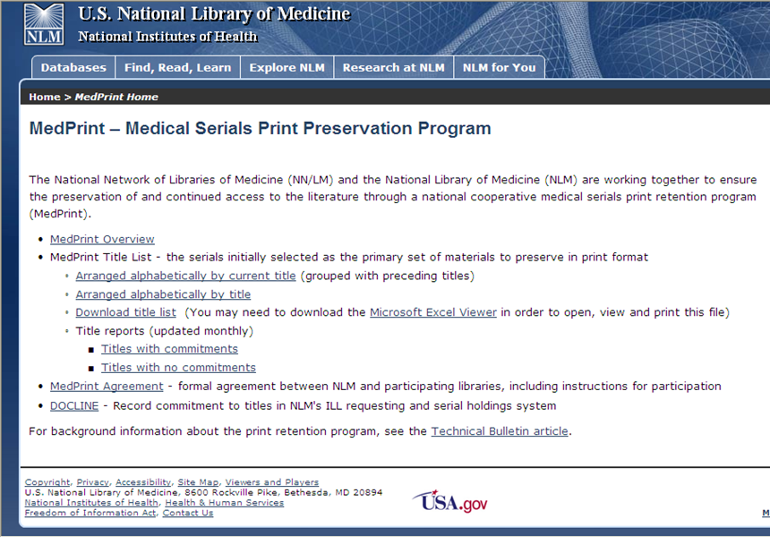
MedPrint homepage
Notes:
This is the MedPrint Home Page – if you forget the url, just type MedPrint into Google and it is the first hit. A recently added feature is monthly reports on titles with commitments, and the remaining few titles with no commitments.

Slide 7
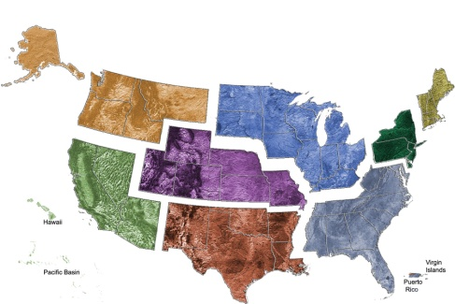
Signed Agreements by Region
1 - Geisinger Health System
1- New York State Nurses Association
1 - Thomas Jefferson University
1 - University of Rochester School of Medicine and Dentistry
2 - University of South Alabama
2 - East Carolina University
2 - University of Tennessee
2 - University of Mississippi
2 - West Virginia University
3 - University of Minnesota
4 - Creighton University
4 – University of Wyoming Libraries
5 – AHEC (U Arkansas Medical Sciences)
5 - Houston Academy of Medicine
5 - University of Texas Medical Branch
6 - University of Washington
7 - Stanford University Medical Center
8 - Baystate Medical Center

Slide 8


MedPrint Libraries & Titles
Libraries
Titles
1
1
5
212
3
74
9
235
7
186
3
13
4
218
7
212
4
207
Notes:
MedPrintLibraries and Titles
Pacific Northwest Region: 5 libraries, 212 titles
Pacific Southwest Region: 4 libraries, 218 titles
Midcontinental Region: 4 libraries, 218 titles
Greater Midwest Region: 3 libraries, 13 titles
South Central: 4 libraries, 207 titles
New England Region: 3 libraries, 74 titles
Midatlantic Region Region: 7 libraries, 186 titles
Souteastern Atlantic Region: 7 libraries, 212 titles
Canada: 1 libraries, 1 titles

Slide 9
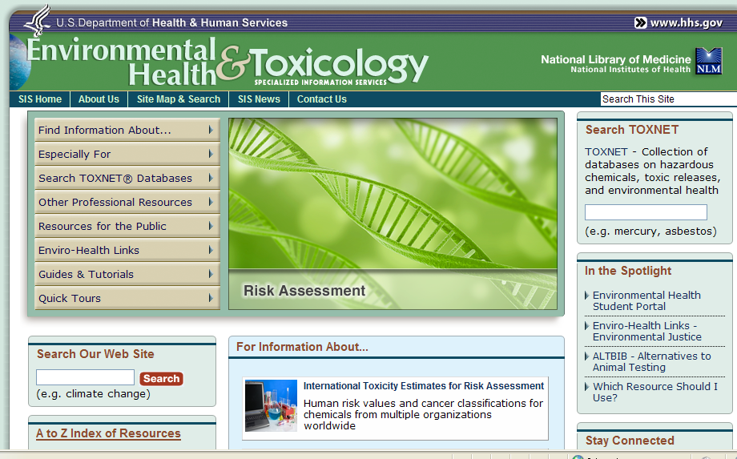
Environmental Health and Toxicology homepage

Slide 10
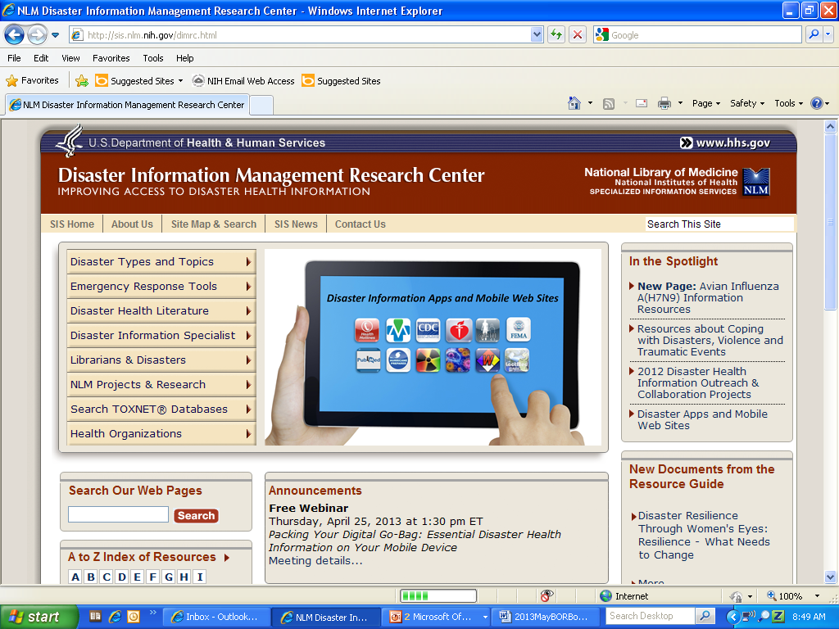
Disaster Information Management Research Center homepage

Slide 11
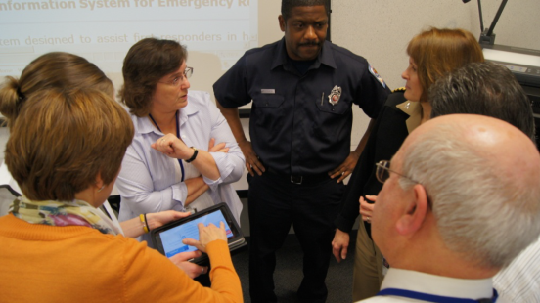
Disaster Info Specialization Program
The Disaster Information Management Research Center at NLM contracted with the Medical Library Association to offer continuing education courses in support of a disaster information specialization for librarians and other interested professionals. http://www.mlanet.org/education/dis
Two levels of specialization
Five new courses added between May-September 2012
Basic Level (5 Required Courses)
Disaster Health Information: The Basics
U.S. Response to Disasters & Public Health Emergencies
Information Roles in Disaster Management
IS-700: National Incident Management, FEMA
IS-100.b: Introduction to Incident Command System, FEMA
Advanced
Additional 12 hours of courses AND/OR experiences participating in disaster information outreach activities
Conference call presentations/webinars such as the recent disaster summits count as credits toward Advanced Level.
Ideas for advanced hours: http://disasterinfo.nlm.nih.gov/dimrc/disasterinfocurriculum.html
Notes:
The Disaster Information Management Research Center within the Specialized Information Services Branch awarded for the first time in 2011 contracts in the amount of $15,000 to $30,000 for collaborations between a library and a disaster-related organization. The intent is to improve access to disaster medicine and public health information for the disaster health workforce. Funds were awarded for another 7 projects in 2012. The maps show the geographical distribution of these contract awards. It is anticipated that funds will be awarded for 2013, but for a smaller number of contracts. Notice of the solicitation will be published on FedBizOps and numerous listservs and other channels.

Slide 12
Future of Resource Sharing Survey
Notes:
Next, I’d like to briefly update you on NLM’s progress in studying the future of resource sharing in the network. We are close to finishing the study now. NLM has no plans to shut down DOCLINE. However, DOCLINE was designed in the mid-1980’s to respond to your needs, the needs of our network libraries , and it is very important that we find out from you what those needs are now and how NLM can help.

Slide 13
I.L.L. Requests in U.S. and Canada in DOCLINE
ILL Requests in US and Canada in DOCLINE
49% decline 2002 - 2012
Notes:
Our study of ILL trends in the network was prompted a few years ago by the decline in DOCLINE use. As you can see, the numbers of ILL requests by DOCLINE libraries continues a significant downward trend. Since the peak in 2002, we have seen a 49% decrease in ILL traffic in DOCLINE.
X axis = requests
Y axis = years
1993 = 2,598,366
1994 = 2,801,712
1995 = 2,993,963
1996 = 2,930,793
1997 = 2,876,861
1998 = 2,916,254
1999 = 3,025,453
2000 = 2,985,212
2001 = 2,923,384
2002 = 3,038,934
2003 = 2,865,964
2004 = 2,704,190
2005 = 2,480,132
2006 = 2,311,516
2007 = 2,102,068
2008 = 1,969,656
2009 = 1,861,208
2010 = 1,765,108
2011 = 1,631,667
2012 = 1,551,541

Slide 14
Strategic Plan: Future of Resource Sharing
“Investigate reasons for declining DOCLINE and document delivery use, determine if other systems are meeting user needs and determine future direction for document delivery.”
Notes:
NLM staff and our RML DOCLINE coordinator staff have asked network libraries about the decline in ILL and what is going on informally. NLM chartered a strategic working group and specifically charged them to investigate the reasons for the decline, find out what network librarians were doing – or what systems they were using to meet the needs of their users – perhaps outside of a traditional ILL model. Let me tell you how we proceeded.

Slide 15
Focus Groups
How do your users access biomedical information ?
What are the challenges you are facing with ILL?
In a perfect world, how would you locate resources for your patrons – for items you do not own?
Notes:
We started last year by convening three focus groups comprising a diverse group of network librarians. We asked them to talk to us about the future of resource sharing. We asked very broad questions --- basically what changes have you seen in how your users access information – what challenges are you facing with ILL --- and also to describe what a “perfect world” would be like for resource sharing.

Slide 16
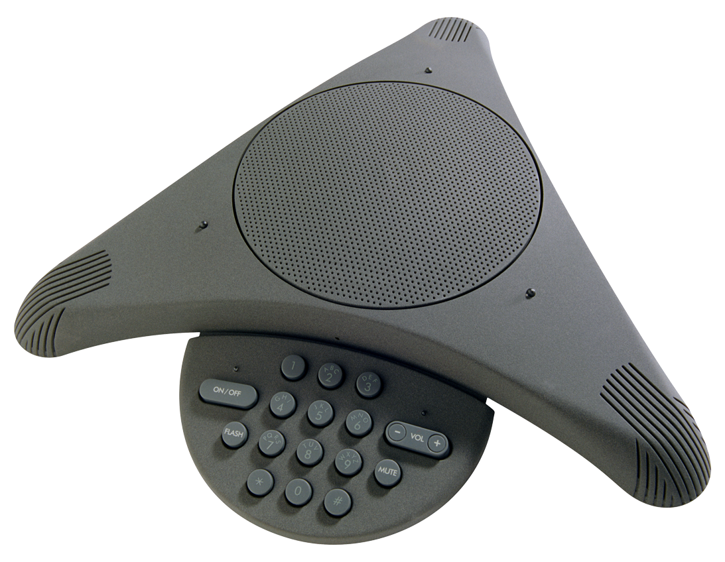
Three Focus Groups
Hospitals
Wilmington VA Medical & Regional Office Center
Columbus Regional Healthcare System
All Children’s Hospital
St. Vincent Hospital
Community Hospital
St. Edward Mercy Medical
Kalispell Regional Medical Center
Kaiser Permanente
Littleton Regional Hospital
Large Libraries
SUNY Downstate Medical Center
Claude Moore Health Sciences
Detroit Medical Center
University of Illinois, Chicago
Tulane University Medical Center
University of Washington Libraries
Yale University
Louise Darling Biomedical Library
Special Libraries
American Dental Association
Fred Hutchinson Cancer Research Center
Pacific College of Oriental Medicine
Southern New York Library Resources Council
New York State Nurses Association
Notes:
We organized the focus groups by library type and size. Here are the names of our hospital, large library, and special library group participants.

Slide 17
Focus Groups
“I hear so many times…that people don’t want to wait. ILL takes too long.”
“The clinicians coming right out of school don’t understand why everything is just not out there available for free.”
“What is the licensing? Some are becoming more and more restrictive for ILL - what does this mean for the future of ILL for all of us?”
“We’d like to provide immediate access to whatever it is our users want. The way we’ve done that historically is by having comprehensive subscriptions and holdings and we don’t have that anymore.”
Notes:
We listened while you told us about your users – and challenges with managing user expectations for speed and ubiquitous online access. You also talked about your difficulties in helping users understand that not everything is instantly available for free. We heard about your concern with e-journal license provisions that restrict ILL.

Slide 18
Feedback from Focus Groups
Users
Want everything now – or never
Prefer remote access to resources
ILL
Licensing challenges for e-journal
Decrease in ILL due to online
Perfect world
Seamless delivery to patron
Need e-pub ahead of print
ILL costs are an issue
DOCLINE improvements – holdings
Don’t take DOCLINE away
Notes:
We transcribed and coded the focus group conversations. You said your users wanted everything right now – or they would move onto another resource. They wanted the latest articles – before they were available in databases or journals. A lot of you never see your patrons in person. Regarding ILL, you told us about challenges with licensing, concerns about raising costs and the fact that ILL use was diminishing when users had access to big journal packages. When you described a “perfect world” for ILL you discussed your desire to provide everything seamlessly to your patrons and your specific recommendations about DOCLINE.

Slide 19
U.S. National Survey: March 2013
  National Survey: March 2013
    2,400 DOCLINE librarians surveyed
    72% partial response rate
    68% complete response rate
  Questions:
    Demographics
    Systems
    Collections
    Budget and staffing
    E-journal licensing
    Lending and borrowing trends
Notes:
We took what we learned from the focus groups and designed our national survey which was administered just a few weeks ago. We sent the survey to slightly over 2,400 possible respondents. The response was wonderful – 68% fully completed surveys. Now some more audience participation – did anyone in the room fill out a survey? Raise your hands so we can see you – thanks so much for your help!

Slide 20
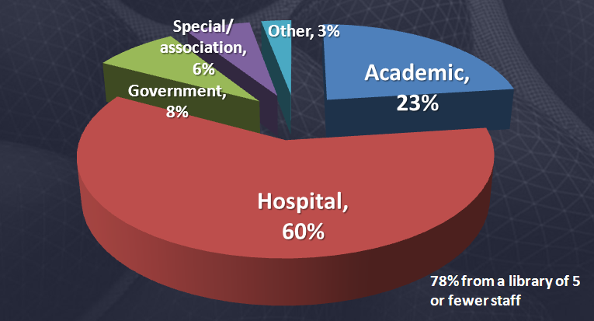
National Survey: March 2013
N=1725
Notes:
As I said we’re in the very early stages of analyzing the survey results. However, I’d like to share some of the preliminary data.
First, most of our respondents identified their organizations as hospitals. We also had almost a quarter identify themselves as academic institutions. Over 40% reported working in a one-person library and spending about 10 hours a week total on ILL activities. About half of the respondents expect that this time commitment will stay about the same over the next two years.
Pie chart of National Survery: March 2013
N=1725
Hospital = 60%
Academic = 23%
Special/association = 6%
78% from a library of 5 or fewer staff

Slide 21
National Survey: March 2013
Notes:
More than half of the respondents indicate that their journal collections are mostly electronic and a smaller percentage – but still about a third – predict collection reductions over the next two years.
While slightly less than half of the respondents stated that their electronic journal license generally permitted ILL -----almost 40% reported that it was difficult for library staff to know the specific license terms for a title. Many requested improvements in DOCLINE to better reflect electronic titles in holdings – particularly to reflect embargo periods.

Slide 22
National Survey: March 2013
If borrowing up --- to support evidence based practice – 66%
If borrowing down – because more open access or online sources available -- 69%
Notes:
Since we know that the usage of DOCLINE has decreased steadily, we were somewhat surprised at the number of libraries who reported no change – or actual increases in borrowing. The most common reason for an increase in borrowing was to support evidenced-based practice.
For those reporting a decline in borrowing activity– a number of reasons were given, which were consistent with what was heard in the focus groups.
Most of our respondents explained that ILL borrowing is declining because their patrons choose resources they can get their hands on immediately – whether in an electronic journal package, or free on the Web. Still, our respondents overwhelmingly predict that they will use ILL as the primary method to obtain sources for patrons over the next two years. Our next task is to complete the analysis of data and the final report. Stay tuned for that. Again, we have no plans to eliminate DOCLINE – we are trying to understand your needs and try to see how NLM can help. Thanks again for your time and efforts in responding to the survey.

Slide 23
Medlineplus

Slide 24
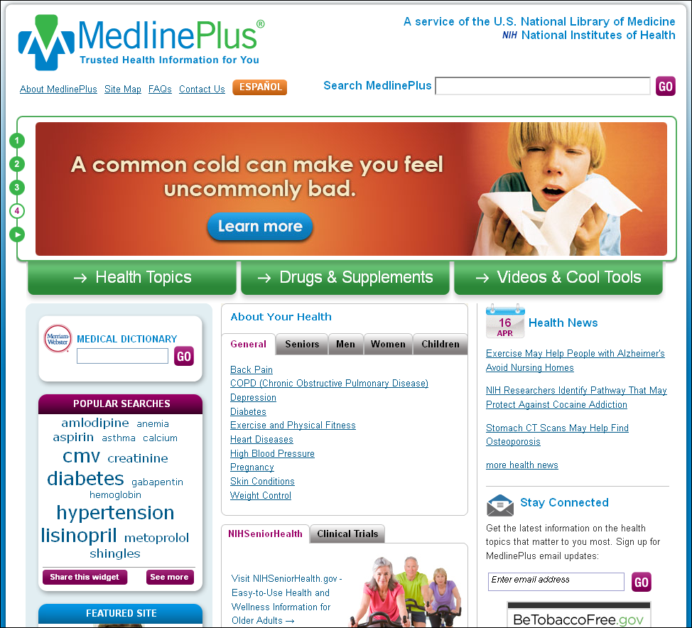
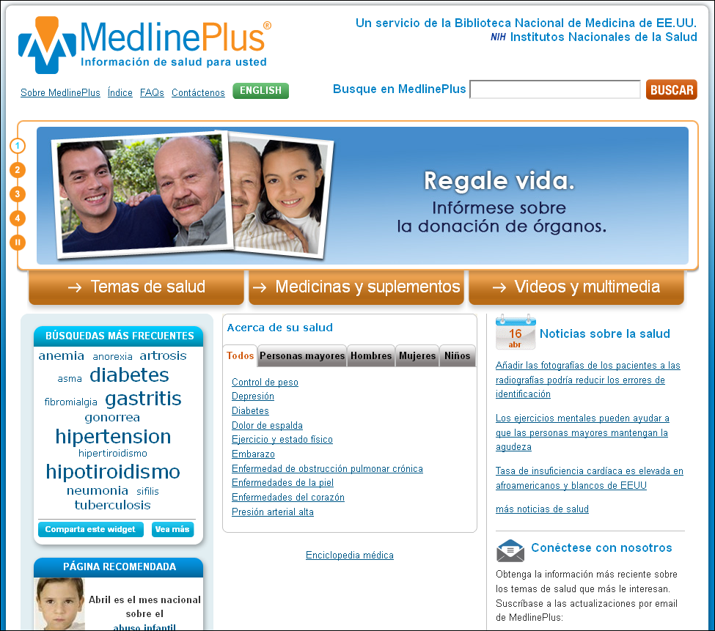
Medline Plus Web Site Changes
15
Years!
10
Years!
Notes:
In 2013 MedlinePlus celebrates its 15th anniversary
And in 2012, MedlinePlus en espanol celebrated its 10th anniversary

Slide 25
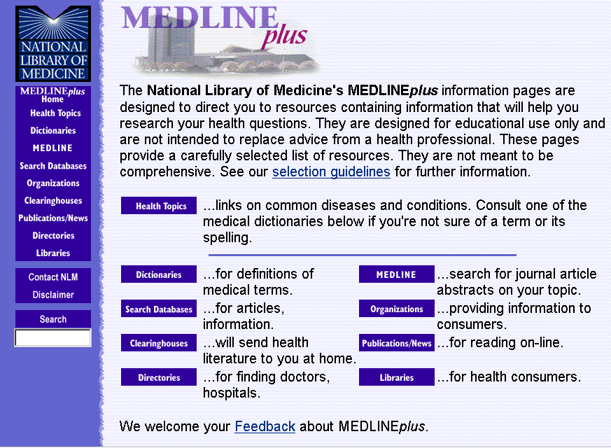
Medline Plus 1998
1998
Notes:
Here’s just a quick walk down memory lane of what MedlinePlus has looked like over the years

Slide 26
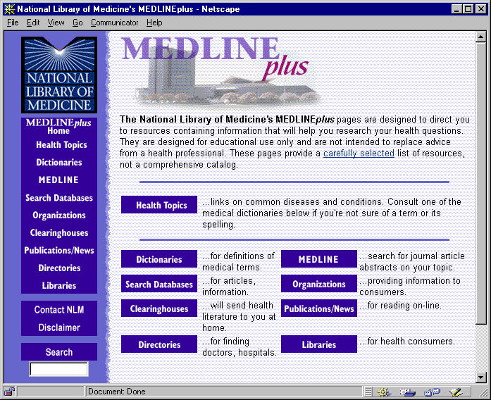
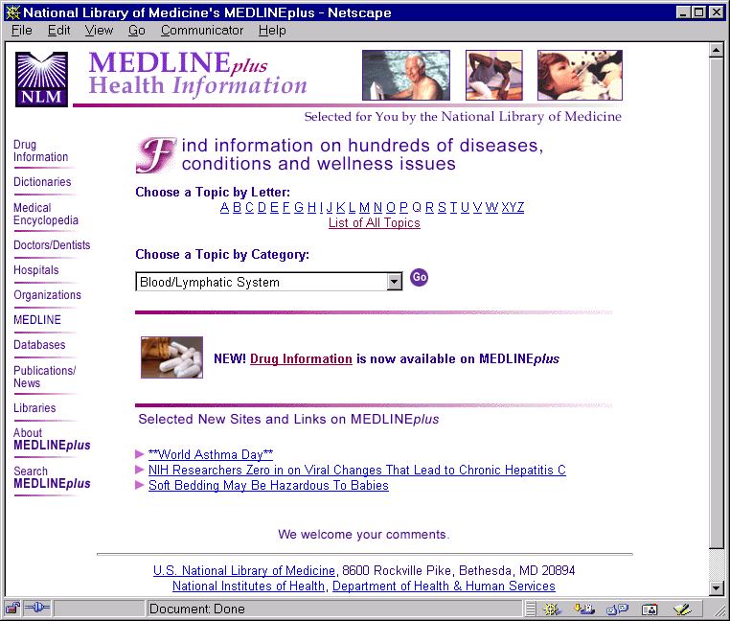
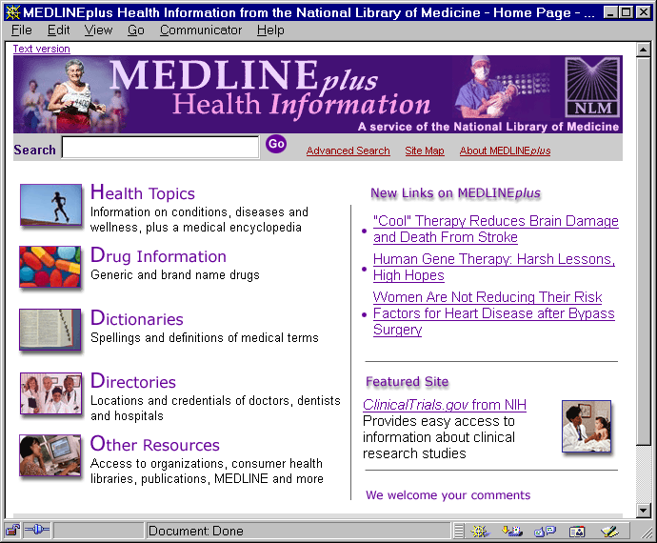
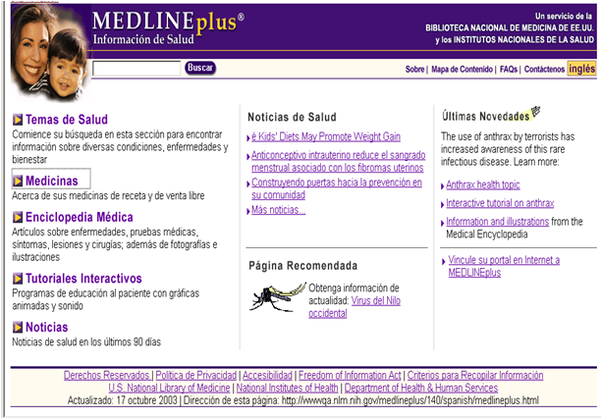
Medline Plus 1998, 1999, 2000, 2002
Oct 1998
Sept 1999
Aug 2000
Sept 2002
Notes:
The dates reflect when these designs debuted.
Note the September 2002 design, in the lower right corner, is the debut of MedlinePlus en español.

Slide 27
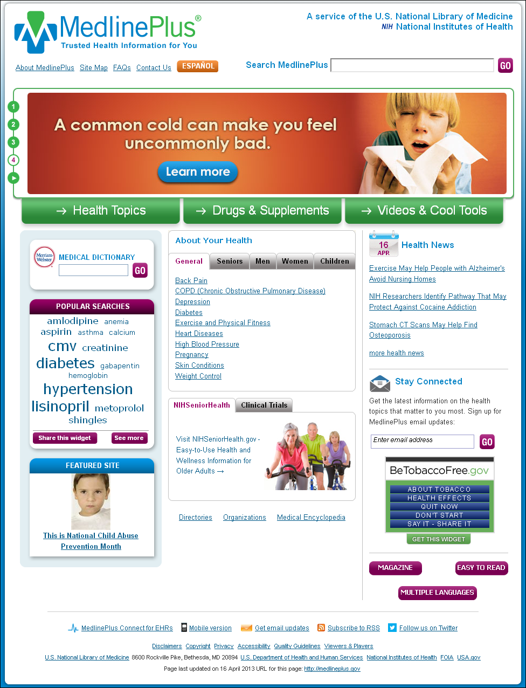

Multiple Languages in Medline Plus
Notes:
One feature that might be of particular interest to this international gathering is the MedlinePlus collection of health information in multiple languages, which you can get to from the M+ homepage, as shown here on this slide.

Slide 28
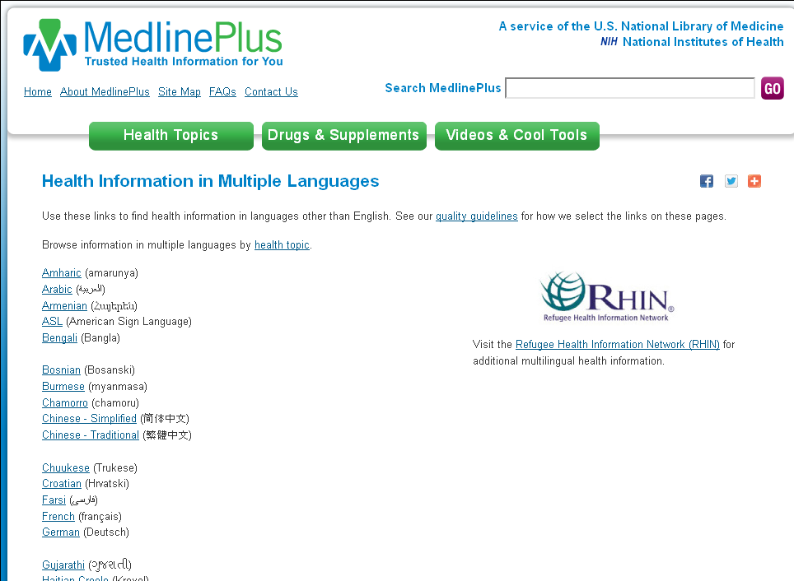
Multiple Languages
Notes:
The M+ multiple languages collection links to over 3,000 documents produced by vetted organizations in almost 50 languages covering nearly 300 topics

Slide 29
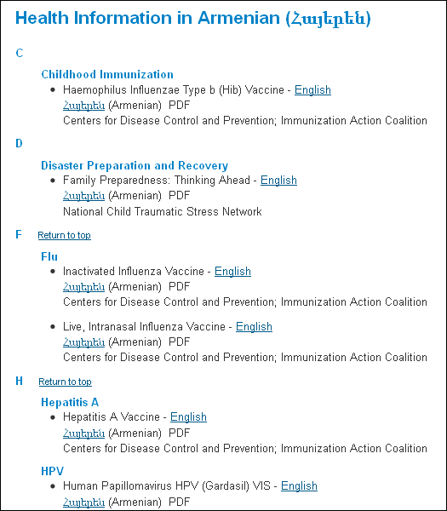
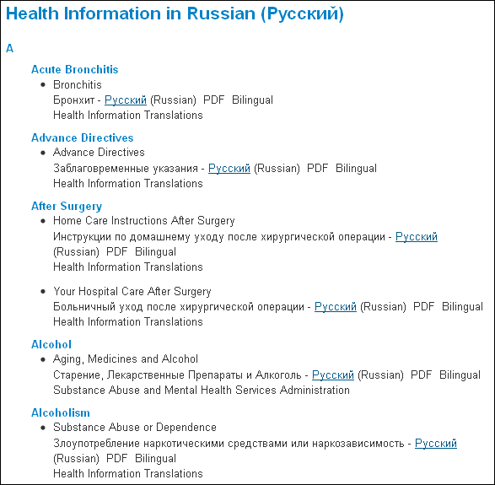
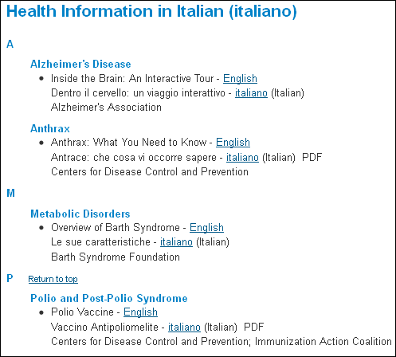
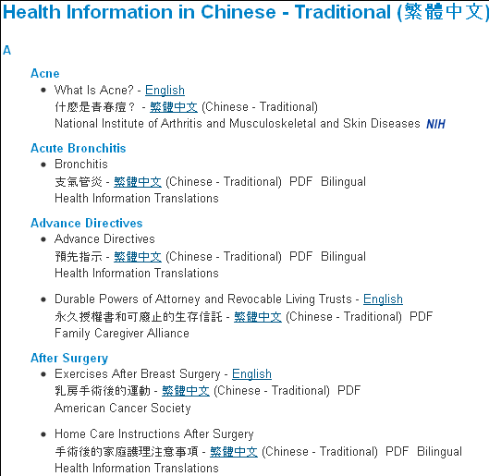
Health Information in Multiple Languages
Notes:
Here are some examples of the languages and topics covered in the collection.
This content is written for a U.S. audience and contains information specific to U.S. medications and practice guidelines. It’s of great use to healthcare providers & information intermediaries, because we link to the document in the language, such as Italian, and its equivalent in English as well.

Slide 30
Visits to Medline Plus by Country
Notes:
While the content on MedlinePlus is written for a U.S. audience, we do get visitors from all over the world. This pie chart shows visits from around the world to MedlinePlus pages for the last quarter of FY12.
The “other” slice of the pie is comprised of over 200 different countries & territories
Visits to MedlinePlus by Country
U.S. = 37%
Mexico = 12%
Spain = 6%
U.K. = 4%
Columbia = 4%
Canada = 4%
Argentina = 4%
Chile = 3%
Uraguay = 2%
Australia = 2%
Other = 22%

Slide 31
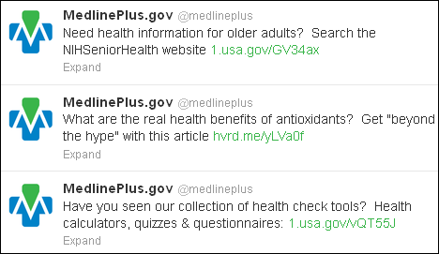
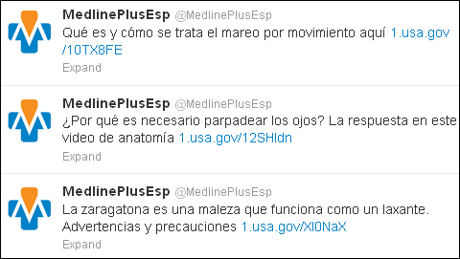
Medline Plus and Medline Plus Espanol on Twitter
Notes:
Twitter
>50,000 @MedlinePlus followers at the end of March (14% growth from the previous quarter and 61% growth from the same time the previous year)
>almost 9,000 @MedlinePlusEsp followers at the end of March (Spanish language tweets) (33% growth from the previous quarter and 446% growth from the same time last year)
Chart:
@MedlinePlus Followers
X axis = number of followers
Y axis = date
December 2009 = 1,000
April 2010 = 1,200
August 2010 = 3,000
December 2010 = 7,500
April 2011 = 10,000
August 2011 = 15,000
December 2011 30,000
April 2012 = 35,000
August 2012 = 40,000
December 2012 = 50,000
Chart:
@MedlinePlusEsp Followers
X axis = number of followers
Y axis = date
November 2011 = 250
January 2012 = 500
March 2012 = 1,750
May 2012 = 2,500
July 2012 = 3,000
September 2012 = 4,500
November 2012 = 6,000
January 2013 = 8,000
March 2013 = 9,000

Slide 32

Contact Medline Plus
Notes:
As always, please continue to send us your questions and comments. Your feedback is vital to helping us continuously improve MedlinePlus and to its success. We thank you for all of your wise feedback of the years and hope you’ll keep it coming.

Slide 33
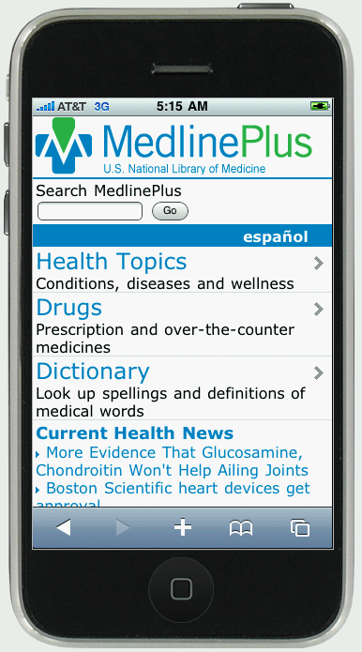
Medline Plus Mobile
m.medlineplus.gov
Notes:
And, as you’ve heard from us before, we are also still providing MedlinePlus content to mobile users in both English & Spanish

Slide 34


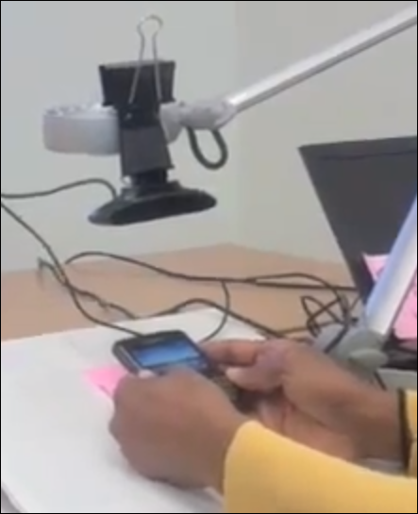


Phase 1 Study Questions
Who is using MedlinePlus Mobile?
What do they do on MedlinePlus Mobile?
Are they satisfied with their visit?
Overview data
  Mobile site
  Mobile use of full site
Notes:
In November 2011 we started a 12-month evaluation of MedlinePlus mobile because we wanted to make sure that we were providing the best service we can to get MedlinePlus content into the hands of mobile users, so they can find reliable health information on the go.
In order to figure out how to provide this excellent service, our study was centered around 3 questions:
Who is using MedlinePlus Mobile?
How are they using MedlinePlus Mobile?
Are they satisfied with their visit to MedlinePlus Mobile?
we also looked at overview data for use of the mobile site and mobile use of the full site
For each of these questions, we have several data points.
And the data points come from a variety of sources.
For this evaluation, we did in-depth analysis of Web analytics data, a user satisfaction survey, and usability testing.
For the Web analytics, we collected data from WebTrends, which is NLM’s enterprise solution for Web analytics, and from Google Analytics, which, as you may know, is a free solution.
For the user satisfaction survey, we used a mobile-optimized version of the American Customer Satisfaction Index, or ACSI, survey in both English and Spanish. This is the same survey tool that we use on the full MedlinePlus site and on other NLM sites. Thank you to all of you who responded to our survey. Your feedback, as always, was extremely helpful.
We also conducted a usability lab test in February through a program which provides usability lab tests for federal government websites.

Slide 35
MedlinePlus Mobile Users – Gender
Notes:
We learned a lot from phase 1 of the M+ mobile evaluation.
Like, who is using the site
Roughly 50/50 men & women
Data is from ACSI survey
Gender, Nov 2011 - August 2012
(n = 1,766 Span) (n= 1,987 Eng)

Slide 36
MedlinePlus Mobile Users – Country
Country | Visits to Mobile English
United States (incl Puerto Rico) | 60%
Canada | 6%
United Kingdom | 4%
Netherlands | 4%
Mexico | 3%
Spain | 2%
Australia | 2%
India | 2%
unresolved | 1%
All others | 16%
Country | Visits to Mobile Spanish
United States (incl Puerto Rico) | 26%
Mexico | 17%
Spain | 12%
Canada | 9%
Argentina | 9%
Colombia | 4%
Chile | 4%
Netherlands | 3%
Uruguay | 3%
All others | 17%
Notes:
From a variety of countries, with most visits from the U.S.
Data here is August 2012
Data here is from WebTrends log analysis
Country/Visits to Mobile English
United States (incl Puerto Rico) = 60%
Canada = 6%
United Kingdom = 4%
Netherlands = 4%
Mexico = 3%
Spain = 2%
Australia = 2%
India = 2%
Unresolved = 1%
All others = 16%

Slide 37
Mobile Visits to MedlinePlus & MedlinePlus Mobile
Notes:
But, perhaps the most interesting thing we found in phase 1 of our evaluation is that, even though increasing numbers of people are using the mobile site & they’re happy with their experience, people are still using the M+ full site with their mobile devices, and that use is HUGE compared to the use of the M+ mobile site.
The red line represents visits to M+ mobile, the blue line represents visits to M+ full site with mobile devices

Slide 38


MedlinePlus Connect
Problem, medication, or lab
code-based request
EHR/Health IT System
MedlinePlus Connect
Consumer health information targeted response
Patient portal
Clinical system
Notes:
MedlinePlus Connect, which is our service that links Electronic Health Records and Health IT Systems with relevant information for patients from MedlinePlus is still going strong. Here’s a quick refresher or how it works…
*click for arrow*
The HER, Patient Portal, or Health IT System sends MedlinePlus Connect the specific problem/diagnosis code, medication code, or lab test code for which it wants related consumer content. The request is sent following the HL7 Context-Aware Knowledge Retrieval (Infobutton) standard, which is a widely accepted standard for requesting and delivering relevant information to patients and clinicians.
*click for next arrow*
MedlinePlus Connect identifies the related MedlinePlus content for that particular code and returns a response to the EHR or PHR.
*click for patient and clinician image*
3. The EHR or PHR then serves up that content for patients or clinicians as appropriate.

Slide 39
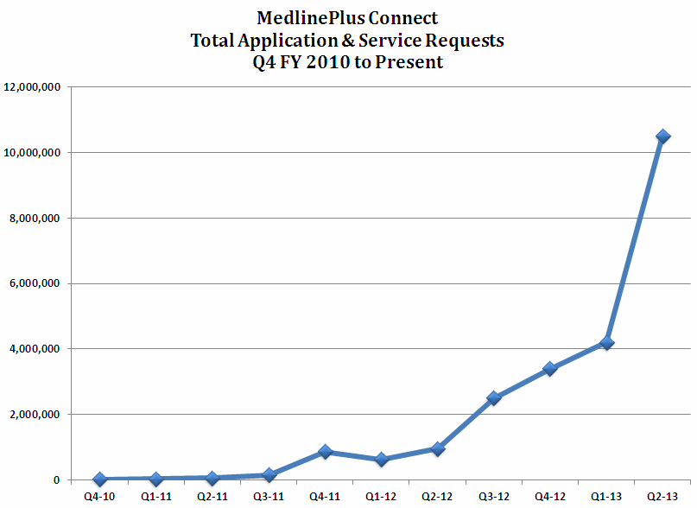
Medline Plus Connect Total Application and Service Requests Q4 2010 to present
Notes:
Since Connect was released in November 2010, use has very trending positive. Here you can see the number of requests received quarterly from Q4 2010 to Q2 2013. By requests, I mean each time the MedlinePlus Connect Web Application or the Medline Plus Connect Web Service receives a request for medication, lab test, or diagnosis information.
As you can see here, in Q2 2013 we received over 10 Million requests.
It is being used in the PHR at Hospital Italiano de Buenos Aires in Argentina. Their CMIO, the Damian Borbolla, has been in touch saying that they use the Web service and send us diagnoses and lab tests. Their PHR is used by over 80,000 patients.
Graph: x axis 2,000,000 to 12,000,000, y axis q4 2010 through q2 2013
Q4 2010 = zero
Q1 2011 = zero
Q2 2011 = 100,000
Q3 2011 = 150,000
Q4 2011 = 1,000,000
Q1 2012 = 900,000
Q2 2012 = 1,000,000
Q3 2012 = 2.25 million
Q4 2012 = 3.3 million
Q1 2013 = 4 million
Q2 2013 = 11 million

Slide 40
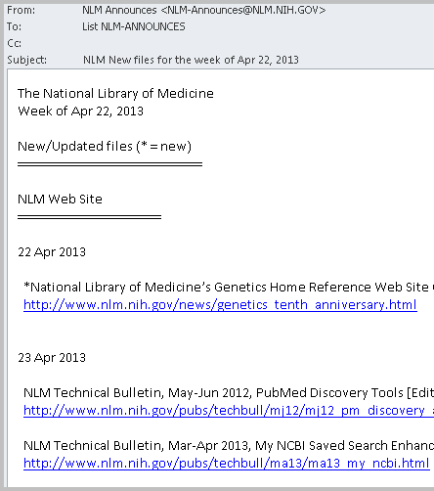
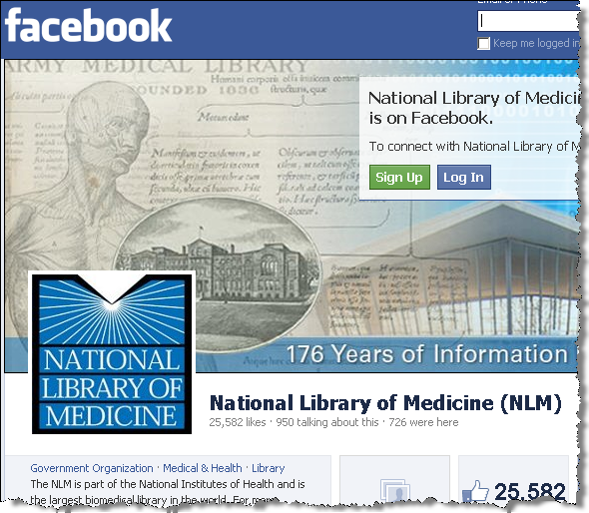
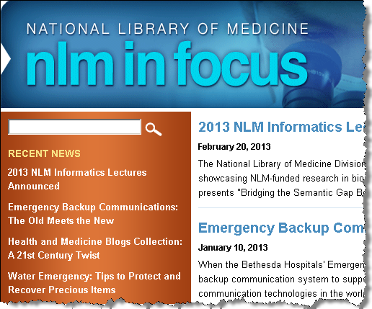
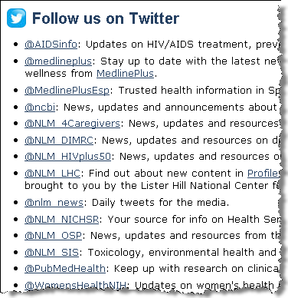
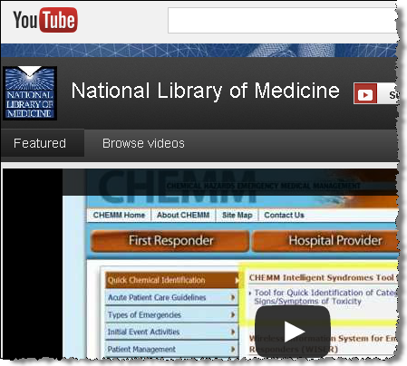
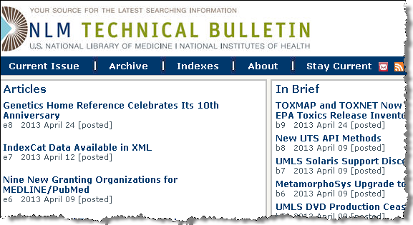
Medline Plus Social Media
Notes:
15 Email lists
14 Twitter feeds
6 Facebook pages
18 RSS feeds
YouTube channel
Perhaps half a dozen blogs and a podcast

Slide 41
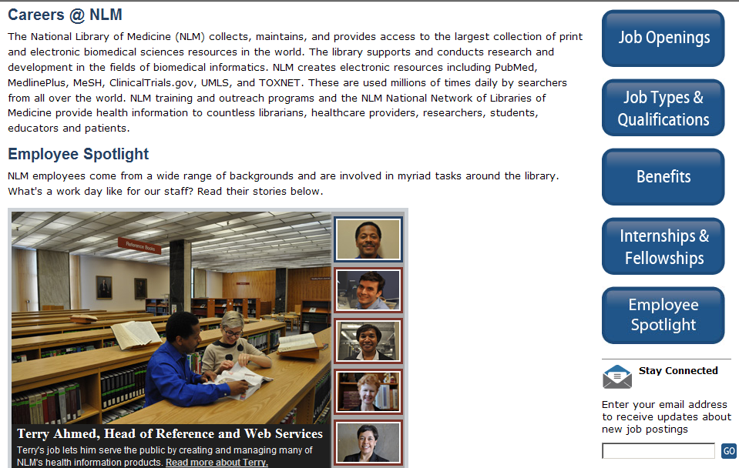
Careers at NLM

